Slide 1
Infrastructure and Service Discovery Protocols for IoT Ecosystem
UNIT-III
Date: 21.04.2022

Slide 2
Overview of UNIT-III
VCE
3CSE 2018

Slide 3
Layered architecture of IoT
Business layer (design, analyze, implement, evaluate, and monitor the requirements of the IoT system)
Application layer (Smart cities, Smart energy, Smart healthcare, Smart transportation )
Service management Service Pairing(Addr,Name) Decision Making
Object abstraction (RFID, 3G, GSM, UMTS, Wi-Fi, Bluetooth low energy, Infrared, ZigBee) eg: Cloud Computing
Objects (Physical devices=Collect and process info.)
VCE

Slide 4
Protocol architecture of IoT
Business layer
Application layer
Service management
Object abstraction
Objects
Application Protocols
Service-Discovery Protocols
Application Protocols

Slide 5
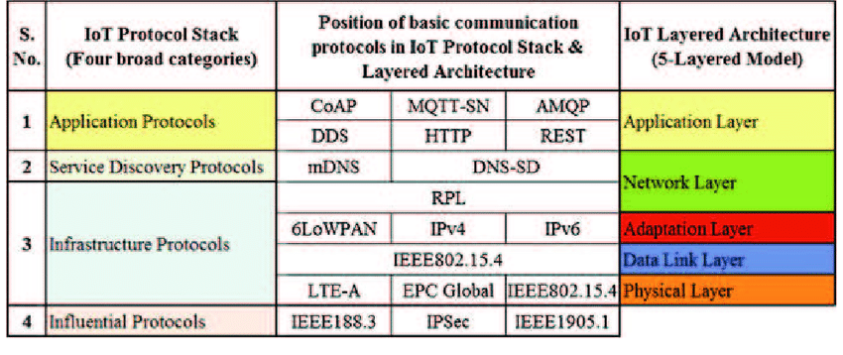
Protocol architecture Conti….

Slide 6
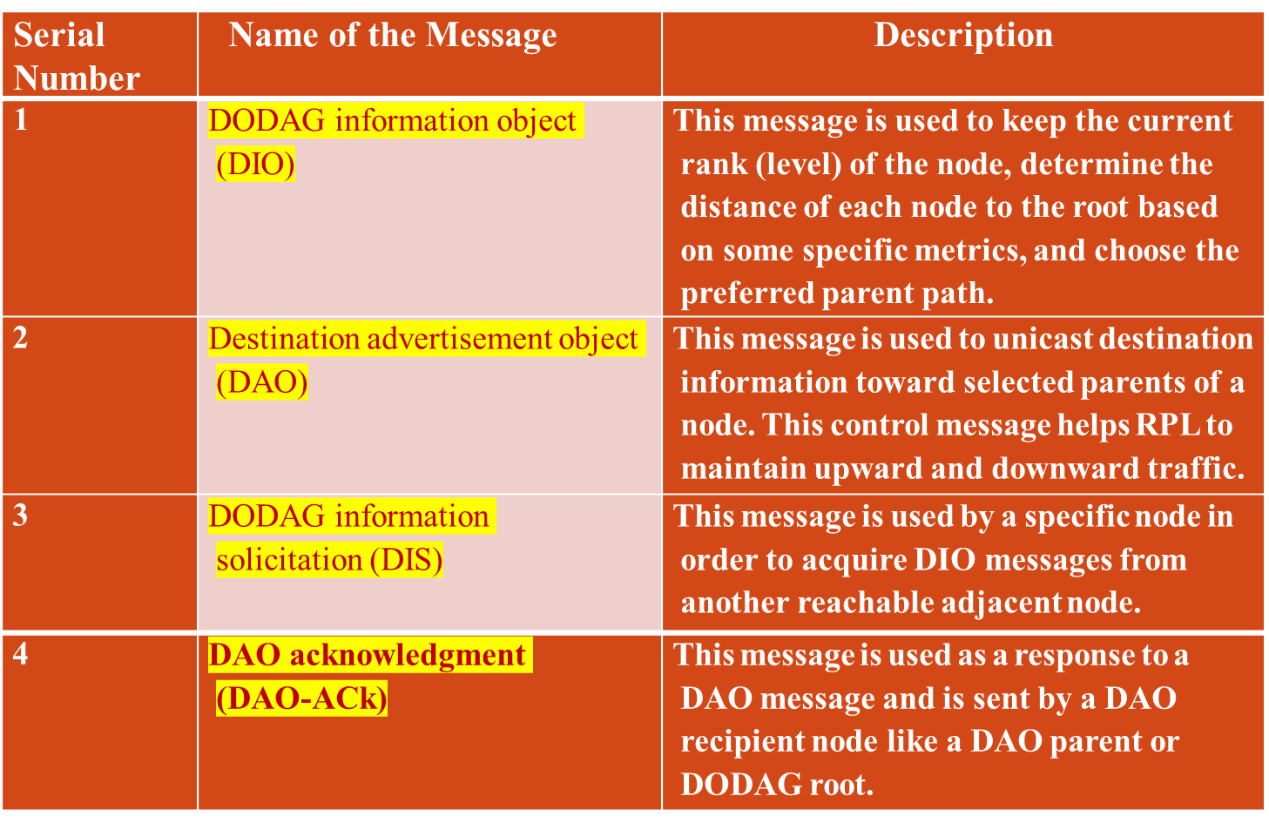
Destination Oriented Directed Acyclic Graph (DODAG):

Slide 7
Architecture of IEEE 802.15.4
Application layer
Application support layer
Eaton’s PSR (Industrial/Commercial)
Ember’s EmberNet (Industrial)
ZigBee (Residential)
Berkeley’s Mote (Academic)
Network layer
MAC sublayer
IEEE 802.15.4
Physical layer
LR-WPAN
(Low-Rate Wireless Private Area Network)

Slide 8
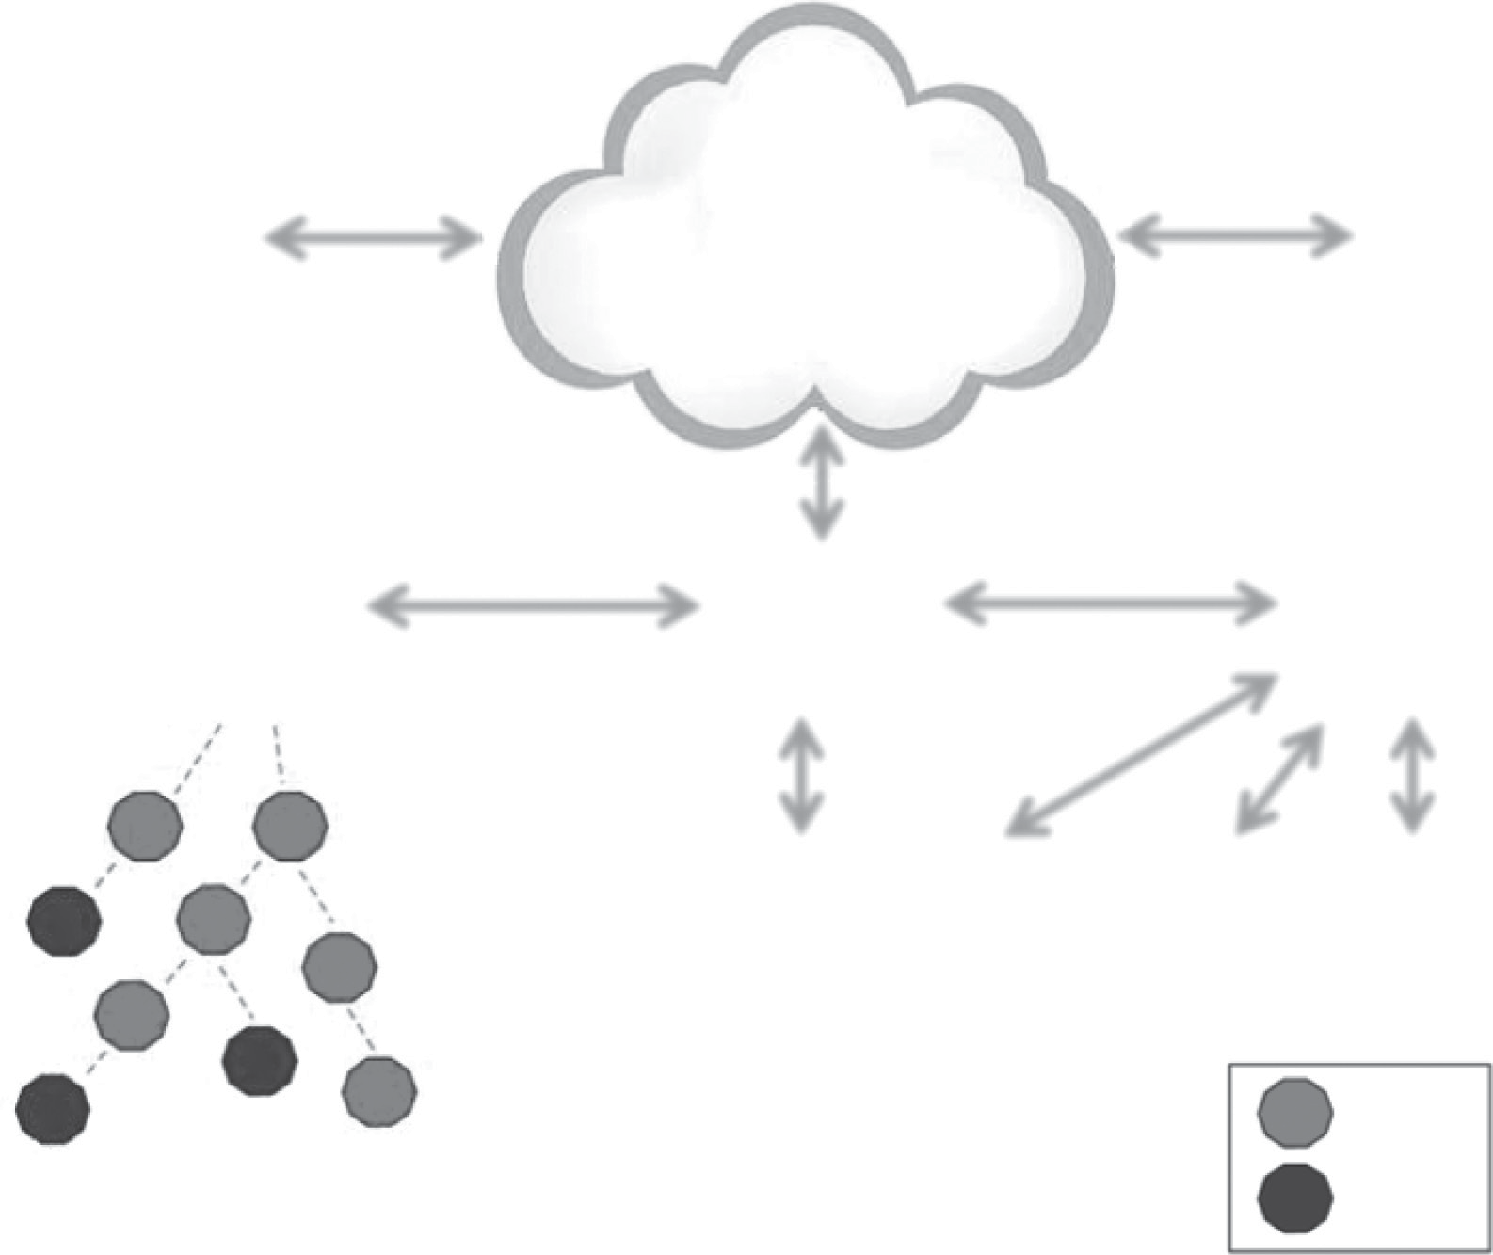
6LoWPAN
Server
Server
2001:1234::1234
2001:4321::4567
6LoWPAN
edge router
Router
Router
2001:8765:23::/48
2001:8765::/48
2001:8765:22::/51
R ::1
R
R
::3
P
C
P
C
P P
C C
2001:8765:22::2 2001:8765:22::3
H
::2
::4
R
2001:8765::5481 2001:8765:22::1
::8
R
::5
H
H
::7
R ::9
R = Router
H = Host
::6

Slide 9

Any Doubts

